Slide 1

Dynamic Load Balancing in SDN-Based Data Center Networks
CS 536 : Data Communication and Computer Networks
Project Presentation
Ramasamy Thiruvenkadam
Nikhil Prakash Js
Manikanta Maddali
Vatsal Pramod Jha
Esha Mudgal
Esha Jugade
Guided by: Prof. Muhammad Shahbaz
12/04/2024

Slide 2
Problem Statement & Advantages
Problem:
Congestion and imbalanced traffic loads in Data Center Networks (DCNs) lead to high delays, packet loss, and inefficient bandwidth utilization.
Advantages of Solution:
Enhanced throughput and reduced latency.
Optimized bandwidth utilization.
Dynamic adaptability to traffic conditions.
Improved user experience with minimized packet loss.
Notes:
"This slide highlights the problem our solution addresses and the advantages it offers.
The primary problem in Data Center Networks, or DCNs, is congestion and imbalanced traffic loads. These issues lead to high delays, significant packet loss, and inefficient utilization of available bandwidth.
To address these challenges, our solution provides several key advantages:
Enhanced throughput and reduced latency, ensuring smoother and faster data transmission across the network.
Optimized bandwidth utilization, effectively distributing traffic to prevent overloading specific links.
Dynamic adaptability to traffic conditions, allowing the network to respond in real-time to changing demands.
Finally, it improves user experience by minimizing packet loss, which is critical for maintaining reliable and consistent performance.
Together, these benefits make our solution a robust approach to solving traffic management challenges in DCNs."

Slide 3
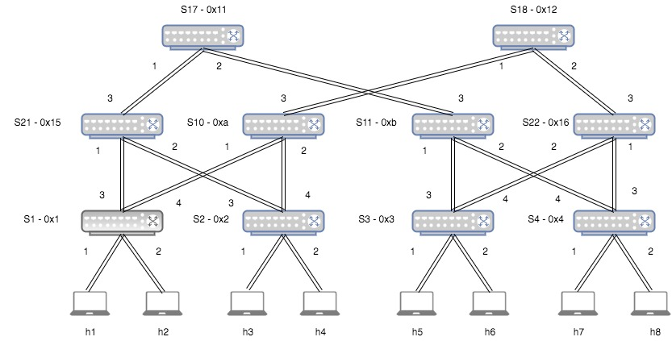
Topology Setup
Configuration:
Fat-tree topology setup in Mininet.
Floodlight controller.
Tools:
Mininet, iPerf, and Wireshark for capturing traffic.
Notes:
"This slide explains the topology setup used in our implementation.
The configuration is based on a fat-tree topology, which is widely used in data center networks for its scalability and redundancy. It has multiple layers of switches, including core, aggregation, and edge switches, which are connected to hosts.
To implement this, we used Mininet for simulating the network environment and the Floodlight controller for managing OpenFlow switches. The controller is responsible for monitoring the network traffic and making routing decisions.
Additionally, the tools used include:
iPerf, which generates traffic between hosts and measures performance metrics like throughput.
Wireshark, used to capture and analyze packet-level details for traffic validation and troubleshooting.
This setup allows us to test the load balancing algorithm under realistic network conditions."

Slide 4
Algorithm Overview
Key Concepts:
Flow prioritization based on traffic requirements.
Dynamic adjustment of link costs.
Path optimization using Dijkstra’s algorithm.
Parameters for Weights:
Link cost = f(current utilization, flow priority, and bandwidth).
Notes:
"This slide provides an overview of the algorithm used for dynamic load balancing.
Key Concepts:
The algorithm prioritizes traffic flows based on their specific requirements, ensuring high-priority flows are given precedence in path selection.
It dynamically adjusts the costs of network links in real-time, allowing for flexible traffic management as conditions change.
The algorithm leverages Dijkstra’s algorithm for path optimization, ensuring that traffic flows take the shortest path with the least congestion.
Parameters for Weights: The link cost is calculated as a function of three key factors:
Current utilization: How much of the link’s capacity is already being used.
Flow priority: Higher priority flows are given preferential treatment.
Bandwidth: The available bandwidth on the link.
This approach ensures that the algorithm can adapt to network conditions dynamically, optimizing traffic distribution and reducing congestion across the network."

Slide 5
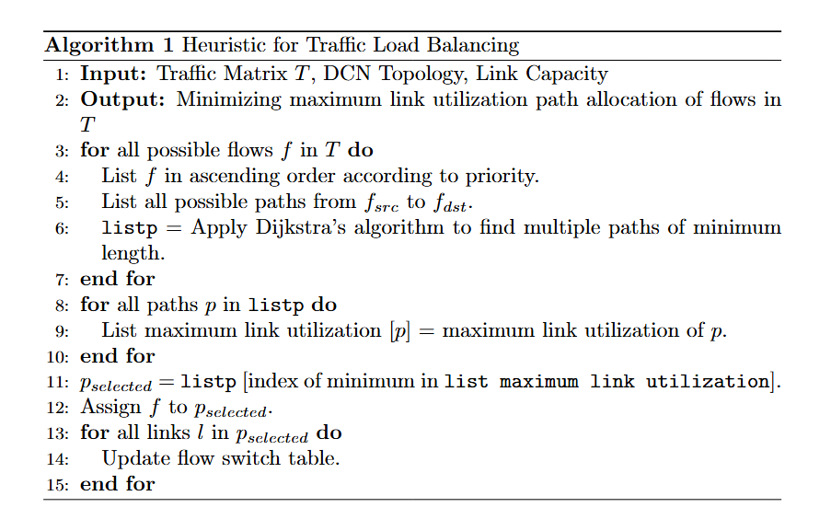
Pseudocode
Paper: Zakia, U., & Ben Yedder, H. (2017). Dynamic load balancing in SDN-based data center networks. Proceedings of the IEEE International Conference on Computer Science and Networking, 1–7.
Notes:
This slide presents the pseudocode for the proposed heuristic algorithm for traffic load balancing.
The algorithm takes three inputs:
The traffic matrix TTT, which defines the flows in the network.
The DCN topology, which describes the structure of the network.
Link capacity, representing the bandwidth constraints of each link.
The goal of the algorithm is to minimize the maximum link utilization across the network by optimally allocating flows.
Here is a step-by-step breakdown of the algorithm:
For each flow, paths are determined using Dijkstra's algorithm, considering minimum length as a criterion.
The maximum link utilization for each path is calculated to identify the most optimal route.
Flows are assigned to paths with the minimum utilization, and the flow switch table is updated accordingly.
This approach ensures efficient traffic distribution, reducing congestion and optimizing bandwidth utilization."

Slide 6
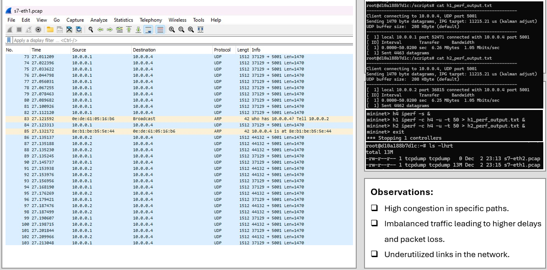
Before Load Balancing
Notes:
"This slide shows the network conditions before load balancing was implemented.
The left-hand side highlights the captured traffic using Wireshark, which shows traffic flows predominantly concentrated on specific links. The source and destination pairs indicate an uneven distribution of traffic across the network.
On the right, the iPerf outputs illustrate limited bandwidth utilization, with both hosts achieving only 1.05 Mbits/sec. This value reflects significant congestion in specific paths, leading to inefficiencies.
Observations:
High congestion is visible on specific paths, leaving some links underutilized.
The imbalanced traffic distribution results in higher delays and potential packet loss.
A lack of dynamic path adjustment exacerbates these inefficiencies.
This highlights the necessity for the dynamic load-balancing algorithm to redistribute traffic and optimize link utilization."

Slide 7
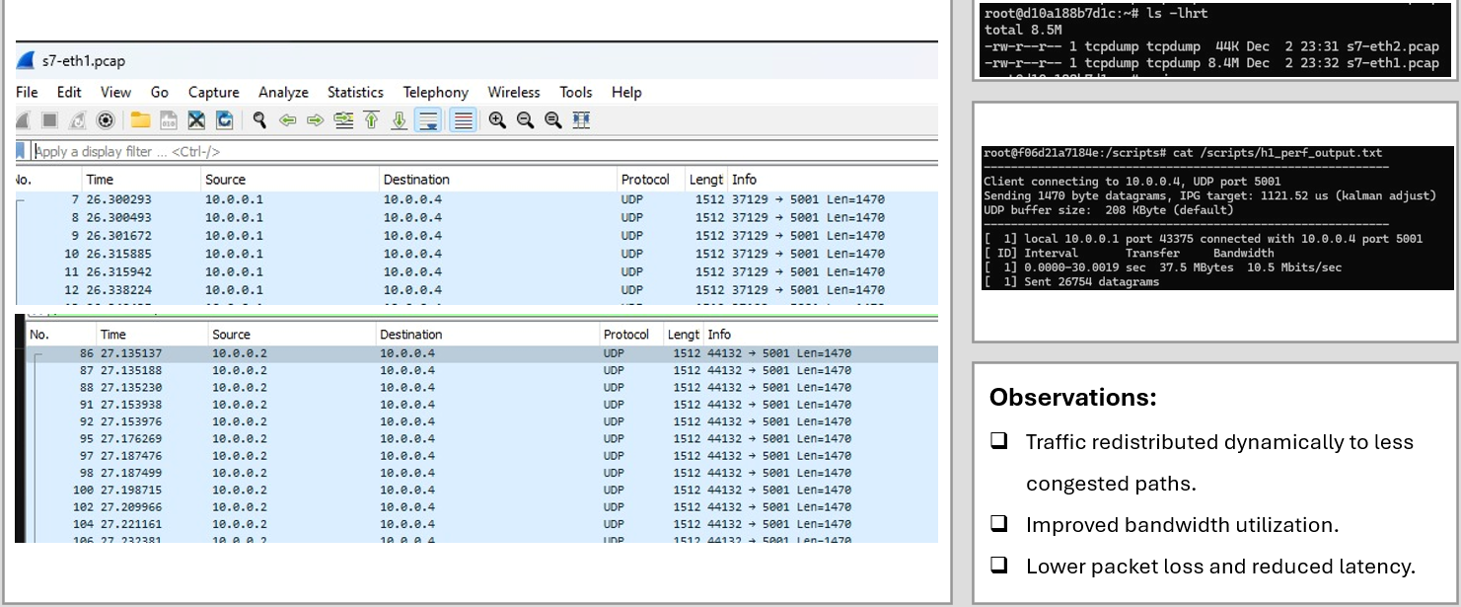
Results - After Load Balancing
Notes:
"This slide demonstrates the results observed after load balancing was implemented.
On the left, the Wireshark captures show a significant redistribution of traffic flows across multiple paths, indicating the effectiveness of the dynamic load balancing algorithm.
On the right, the iPerf outputs highlight the improvements:
Bandwidth utilization increased substantially to 10.5 Mbits/sec, compared to the previous 1.05 Mbits/sec.
Traffic flows were dynamically redirected to less congested paths, optimizing the network's overall performance.
Observations:
Traffic is now redistributed dynamically, avoiding heavily congested paths.
Bandwidth utilization is significantly improved, leveraging previously underutilized links.
Packet loss is reduced, and latency is lowered, leading to better network reliability and user experience.
These results validate the efficiency of the load-balancing algorithm in managing traffic dynamically and improving network performance."

Slide 8
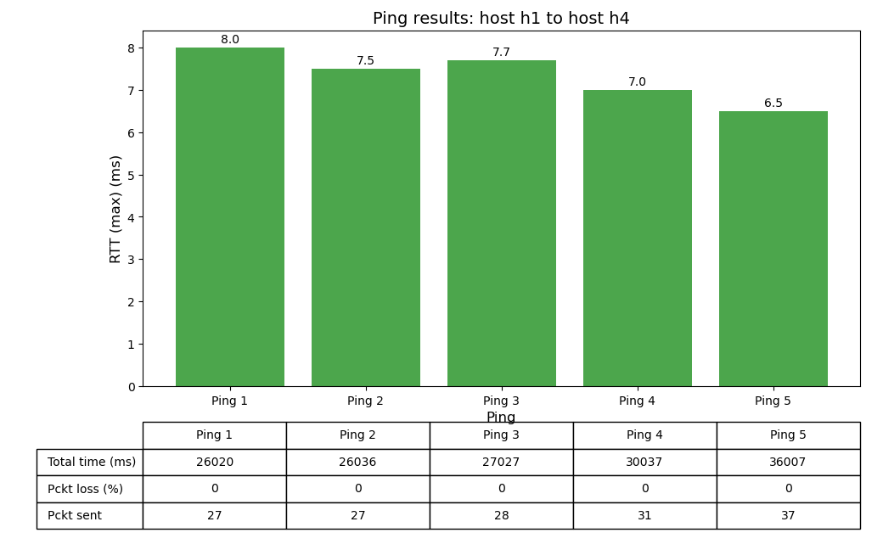
Results
Notes:
"This slide presents the detailed results of the network performance after load balancing, as observed through a series of pings between host h1 and host h4.
Graph Analysis:
The bar chart shows the maximum Round Trip Time (RTT) for five different ping trials.
As the load balancing algorithm redistributes traffic, RTT decreases steadily, starting from 8.0 ms in the first trial and improving to 6.5 ms in the fifth trial.
Table Details:
The table below provides additional metrics for each ping trial:
Total time: Indicates the duration of each ping test.
Packet loss: Remains consistently at 0%, showcasing reliability.
Packets sent: Increases across trials, confirming better traffic handling and throughput.
Overall, the results demonstrate how the load balancing algorithm improves network efficiency by reducing RTT and ensuring zero packet loss, even as the network load increases."

Slide 9
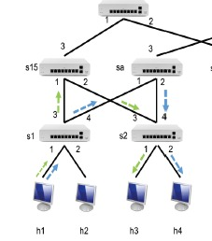
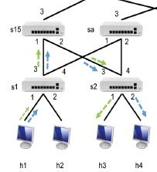
Results
Before Load Balancing
After Load Balancing
Paper: Zakia, U., & Ben Yedder, H. (2017). Dynamic load balancing in SDN-based data center networks. Proceedings of the IEEE International Conference on Computer Science and Networking, 1–7.
Notes:
"This slide visually compares the network state before and after implementing the dynamic load-balancing algorithm.
Before Load Balancing:
As shown on the left, traffic is concentrated on specific paths, leading to uneven distribution and congestion. Some links are overloaded while others remain underutilized, resulting in inefficiencies.
After Load Balancing:
On the right, the algorithm has dynamically redistributed the traffic across multiple paths, achieving a more balanced utilization of network resources.
Previously overloaded links now share the traffic with alternate paths, optimizing the entire network's performance.
This visual effectively demonstrates the algorithm's capability to improve traffic management and reduce congestion, validating its practical application in data center networks."

Slide 10
Limitations
Key Constraints:
Algorithm focuses only on link utilization; node utilization is not considered.
Scalability is limited to the fat-tree topology tested.
Limited Adaptability to Real-Time Network Changes.
Notes:
"This slide highlights some of the key limitations of the proposed dynamic load-balancing algorithm:
Focus on Link Utilization:
The algorithm primarily considers link utilization and overlooks node utilization, such as switch or host processing capabilities. This may lead to imbalanced workloads on individual nodes, potentially bottlenecking performance.
Scalability:
The scalability of the algorithm has only been tested within the constraints of the fat-tree topology. Applying it to larger or more complex network topologies may require further adjustments and validations.
Adaptability to Real-Time Network Changes:
While the algorithm dynamically balances traffic based on current conditions, it may struggle to respond to highly dynamic and unpredictable traffic patterns, limiting its effectiveness in real-world scenarios with rapidly fluctuating loads.
These constraints present opportunities for further research and enhancements, such as integrating node-level metrics, expanding scalability tests, and improving real-time adaptability."

Slide 11
Conclusion
Summary:
Successfully implemented an SDN-based dynamic load balancing algorithm.
Improved performance metrics: throughput, packet loss, and delay.
Notes:
"This slide provides the conclusion and highlights the achievements and future directions of our work.
Summary:
We successfully implemented an SDN-based dynamic load balancing algorithm.
The algorithm demonstrated improvements in key performance metrics, including throughput, reduced packet loss, and lower delays, validating its effectiveness.
Future Directions:
Incorporate Node Utilization Metrics:
Expanding the algorithm to account for node-level metrics like CPU and memory utilization, ensuring a holistic balance across the network.
Test Scalability:
Extending the tests to larger and more complex network topologies, verifying the algorithm's adaptability to diverse environments.
Explore Energy-Efficient Routing:
Investigating methods to reduce the energy consumption of the network, aligning with sustainability goals.
In conclusion, this work offers a robust solution to improve traffic management in data center networks while paving the way for future enhancements."

Slide 12
THANK YOU!

